Slide 1

Predicting Car Prices:
This presentation details our machine learning approach. Our model accurately predicts car prices. It helps customers, dealers, and manufacturers.

Slide 2

Objective: Accurate Car Valuation
Predict Car Prices
Informed Decisions
Feature-Based Analysis
Our core objective is precise price prediction. It uses various car features.
Customers, dealers, and manufacturers benefit. They make data-driven choices.
Brand, engine size, and horsepower are key. Fuel type and car body are also included.

Slide 3

Dataset Insights
Total Records
205
Features
26 columns
Target Variable
price
Unique Identifiers
car_ID, CarName
The dataset contains 205 records. It has 26 features. The target variable is car price.

Slide 4
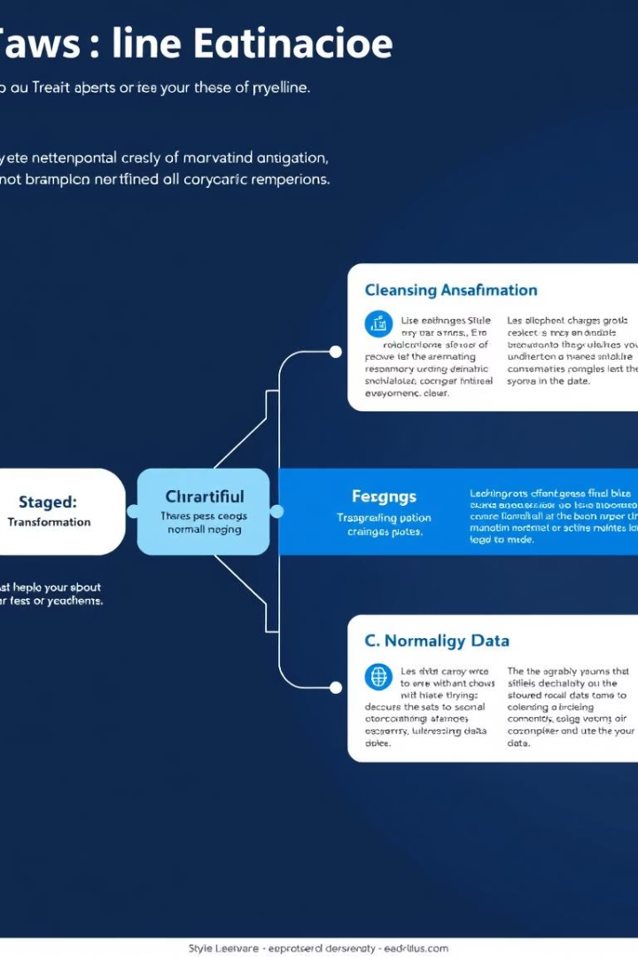




Data Preprocessing Pipeline
CarName Cleanup
Brand names extracted from CarName.
Categorical Encoding
One-hot encoding applied for conversion.
Null Value Check
No missing values found.
Normalization
StandardScaler used for scaling.
Our preprocessing steps ensure data quality. We cleaned car names. Categorical variables were encoded. Numerical features were normalized.

Slide 5
Modeling Approach and Selection
Data Split
Selection Criteria
Train-test split performed. Ratios typically 70:30 or 80:20.
R² Score
Mean Squared Error (MSE)
Models Explored
Root Mean Squared Error (RMSE)
Linear Regression
We used diverse models. We evaluated performance rigorously. Selection relied on key regression metrics.
Lasso Regression
Ridge Regression
Decision Tree Regressor
Random Forest Regressor

Slide 6
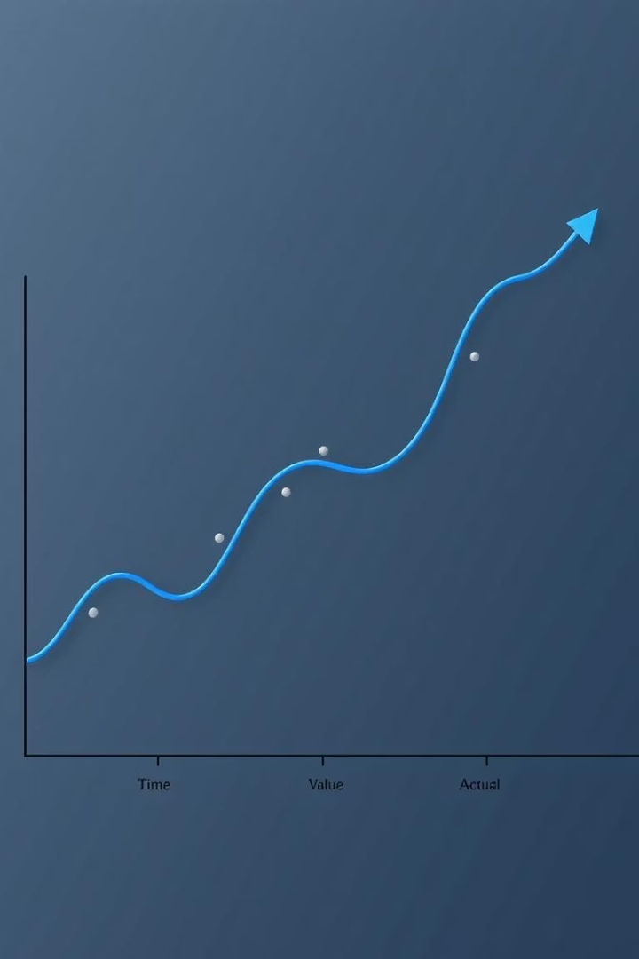
Model Performance: Random Forest
0.90+
Low
R² Score
RMSE Values
Achieved on the test set. Indicates strong predictive power.
Implies minimal prediction error.
The Random Forest Regressor excelled. It achieved a high R² score. Low RMSE confirms prediction accuracy.

Slide 7
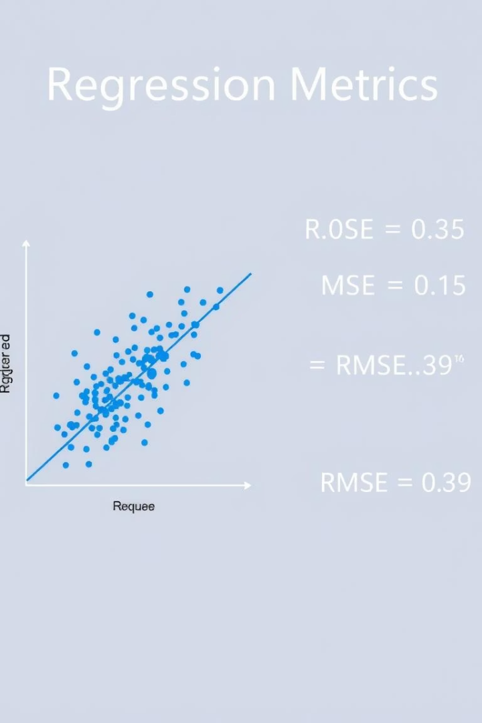
Evaluation Metrics for Regression
R² Score
Mean Squared Error (MSE)
Measures proportion of variance. Explains target variable.
Average of squared errors. Penalizes larger errors.
Root Mean Squared Error (RMSE)
Square root of MSE. Interpretable in target units.
For regression, we use specific metrics. ROC curves are not applicable here. These metrics quantify model fit and error.

Slide 8
Conclusion
The dataset is clean and well-structured.
Random Forest Regressor performed best. It accurately predicts car prices.
The model is reliable for new data.
Future work includes deep learning. Hyperparameter tuning will enhance performance.
Our model provides reliable car price predictions. We plan continuous improvements. These will leverage advanced techniques.

